Slide 1

AI Invasion Day 1 – Introduction to Machine Learning Part 1
Presented By: Abimbola Olawale Victor
abimbolaolawale41@gmail.com
Kaggle.com/olawalevictor1
Zindi.africa/users/olawale0254_DSN
https://github.com/olawale0254

Slide 2


About Data Science Nigeria
Data Science Nigeria is a non-profit driven by a vision to build a world-class Artificial Intelligence knowledge, research and innovation ecosystem that delivers high impact research, business use applications, locally-relevant AI-first start-ups, increase employability and drive for social good use cases.

Slide 3
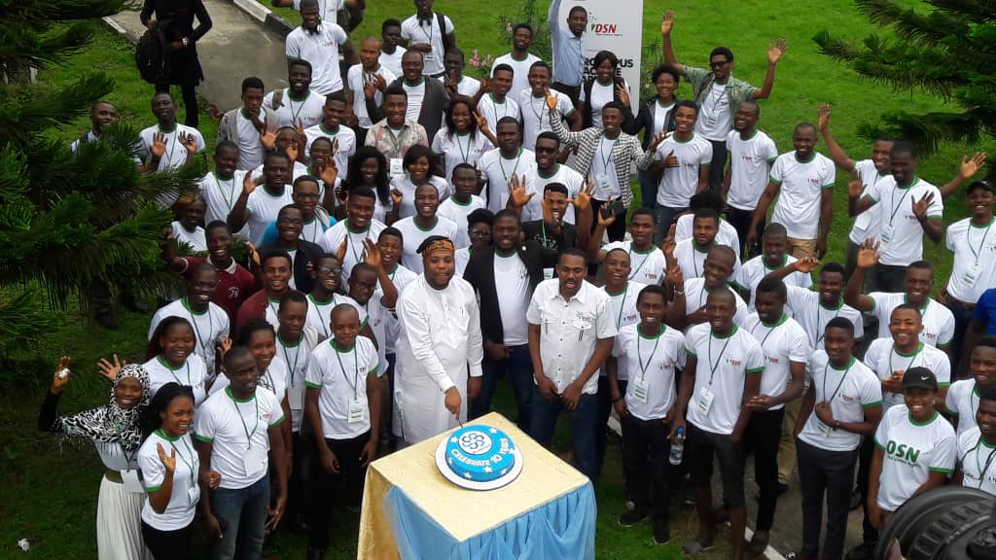
About Data Science Nigeria

Slide 4
KEY MILESTONES OF DSN
300,000+ direct download of our Artificial Intelligence for Starter free ebook with contribution from recognized leaders like Prof Yoshua Bengio .
10,212 participated in the 1st ever Intercampus Machine Learning competition that involved 95 universities.
12,234 online participants in Data Science course
Over 1,000 have participated in our face to face classes via fully residential all-expense-paid bootcamp, free meet-ups and weekly classes at the AI Hub.
203 direct job placement, project participation and internship.
4 innovative product ideas that are being pre-incubated
The largest convergence of academia and industry practitioners as mentors to support real-world application of learning.
High impact learning bootcamps, academic engagement and direct job placements (full time, freelance and internships) for young Nigerian data scientists
Strategic partnership with leading firms and organisation. e.t.c

Slide 5

ABOUT THE FOUNDER
Dr Bayo is a transformational leader with a strong passion to add value to the next generation and build a sustainable platform for shared value creation. He is a leading expert in Strategy, Marketing and Analytics, whose career path is an interception of the dual domains of the academia/business world, magic/ logic of customer engagement and creativity/analytics.
DR BAYO ADEKANMBI
CHIEF TECHNOLOGY OFFICER MTN NIGERIA

Slide 6
About The Founder
Previously served as General Manager Business Intelligence and Chief Marketing/Strategy Officer.
Awarded the prestigious MTN Yello Star award for the conceptualisation of a Customer Value/Risk Management framework, which led to multi-billion naira revenue growth.

Slide 7
About The Founder
A practising Data Scientist who is validated by Kaggle
No 1 on the Data Science Dojo In-class Capstone project Leaderboard
https://inclass.kaggle.com/c/datasciencedojo-capstone/leaderboard
Top 1% (No 29 out of a total of 7,068 teams) of Data scientists competing on Kaggle Titanic Machine learning survival model
https://www.kaggle.com/c/titanic/leaderboard
Patent owner (United States Patent Office final approval stage) for a Data Science product
Social Pricing Recommender algorithm for low income prepaid telecommunication users using uncalled-called numbers modelling (US62400186)

Slide 8
About The Founder
Doctoral-level scholar on a combined PhD programme at the City University London and TIAS Business School, the Netherlands
Research work on application of Data science algorithm to understand the effect of customer social networks on consumption behaviour in luxury and telecoms industry.
Author of The Future is Shared : Sharing Economy and Sharepreneurship in emerging market.

Slide 9



About Me
Name is Abimbola Olawale Victor
Graduate of Mathematics and Statistics
Self Developed Data Scientist
I play with HTML
Statistician
Data Analyst
Emerging machine learning expert
AI enthusiast
Done a couple of research on Neural Networks, Facial Recognition System and Natural Language Process (yet to be published)
Participated in different Machine Learning Competition
Research interest – Computer Vision and NLP
@Abimbolaolawa10
@Mr_whales
@abimbola-olawale
@Abimbola Olawale Victor

Slide 10

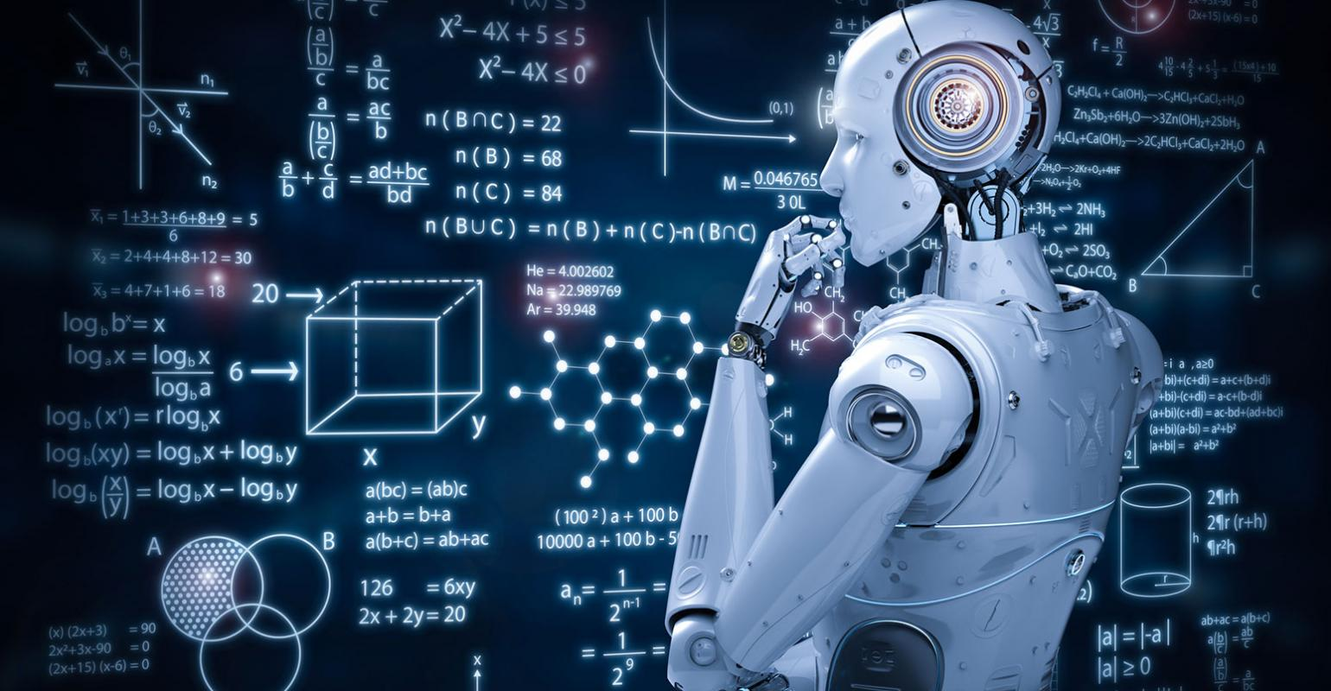
What is Machine Learning?
Machine Learning is a branch of Artificial Intelligence (AI), which helps making machines capable of learning from observational data without being explicitly programmed. It’s not like that, Machine learning or ML and Artificial Intelligence or AI are the same. There are a lot of differences as well a lot of similarities. Alternatively, we can also say that, Machine learning is a component of AI.

Slide 11
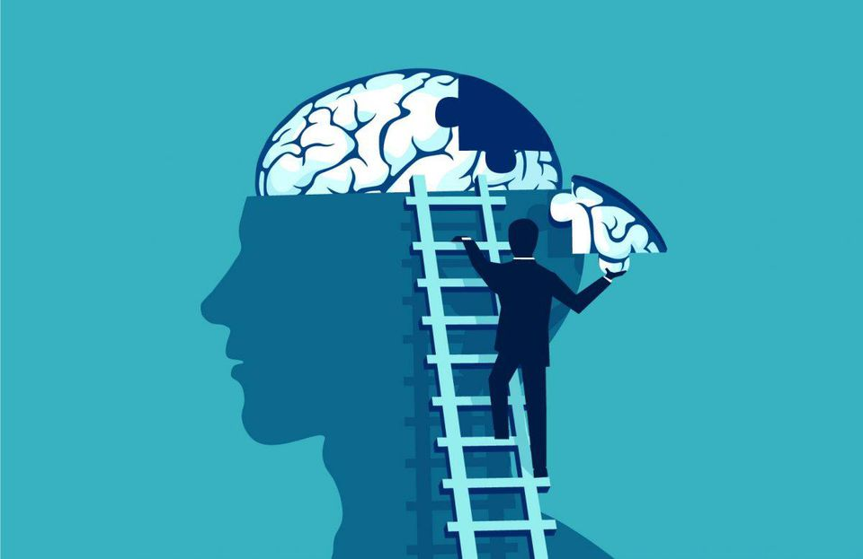
Machine learning(ML) vs. Artificial intelligence(AI)
People tend to use machine learning and artificial intelligence as if they’re interchangeable, but they’re not: rather, machine learning (ML) is one very successful approach to the broader field of artificial intelligence (AI).
Artificial intelligence is, essentially, the simulation of intelligence in computers. As such, it’s something that people have been working on for decades.

Slide 12
Machine learning(ML) vs. Artificial intelligence(AI) cont.
Machine learning, on the other hand, is a form of artificial intelligence in which the computer learns for itself how to complete a task. And it’s this that has been at the heart of many of the recent huge developments in the field of AI, which might explain why interest in it has grown so much over the last few years.

Slide 13
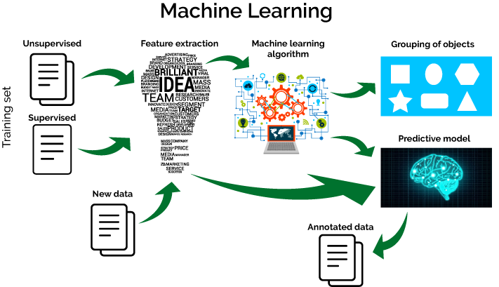
But what it does actually or why do we need ML or AI?
Machine Learning and Artificial Intelligence (AI) are based on automated and self-training algorithm to learn from prior data in order to find the pattern, which exists within, and then help machines to make decisions in situations they have never seen. Machine learning is expanding its reach to various domains.

Slide 14
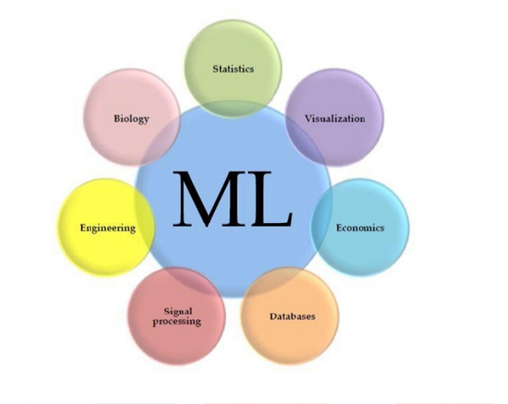
It is an Interdisciplinary Field
Good in Mathematics or Statistics than a Software engineer, better in software engineering than any other mathematician or statistician

Slide 15
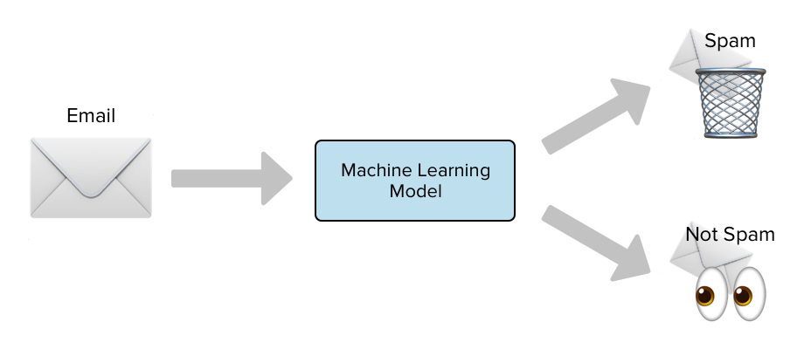

Example of ML projects
Spam Detection
When Google Mail detects your spam mail automatically, it is as a result of applying machine learning techniques.

Slide 16
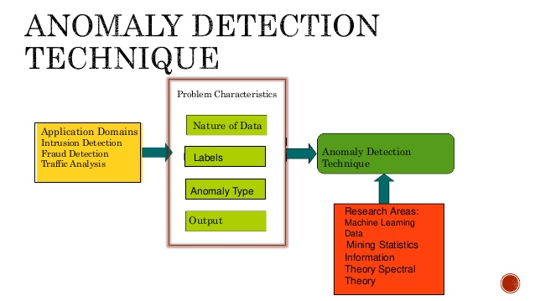
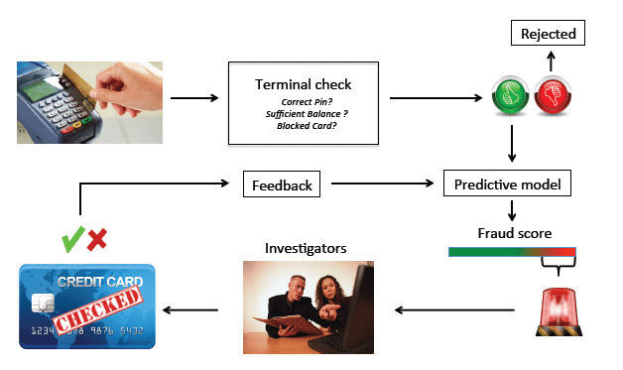
Example of ML projects
Credit Card Frauds
Identifying 'unusual' activities on a credit card is often a machine-learning problem involving anomaly detection.

Slide 17

Example of ML projects
Product Recommendation
Whether Netflix was suggesting you watch House of Cards or Amazon was insisting you finally buy those Bose headphones, it's not magic, but machine learning at work.

Slide 18

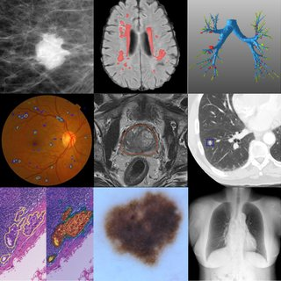
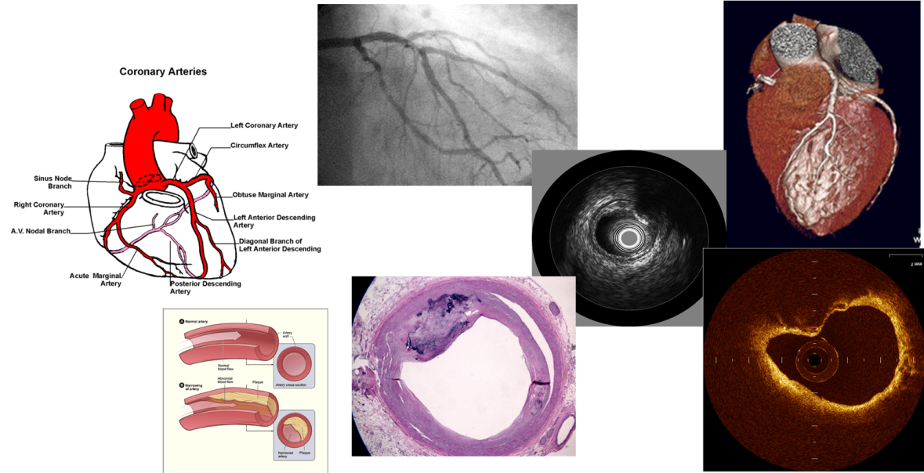
Example of ML projects
Medical Diagnosis
Using a database of symptoms and treatments of patients, a popular machine learning problem is to predict if a patient has a particular illness.

Slide 19
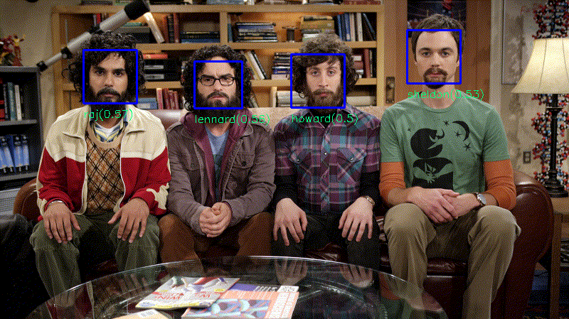
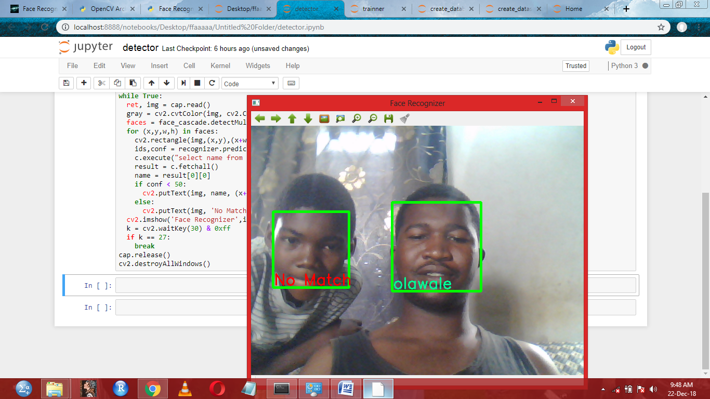
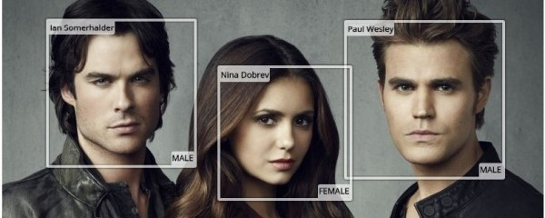
Example of ML projects
Face Detection
When Facebook automatically recognizes faces of your friends in a photo, a machine learning process is what's running in the background.

Slide 20
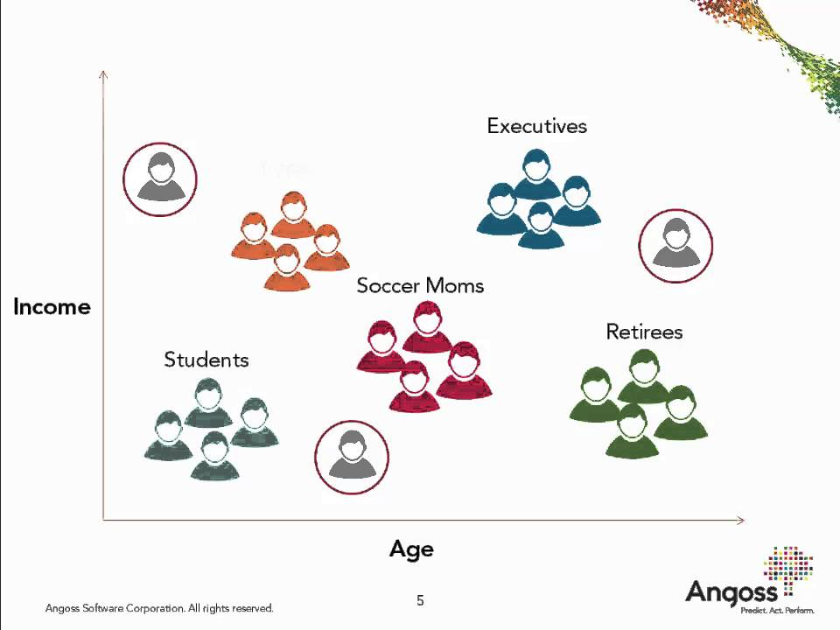
Example of ML projects
Customer Segmentation
Using Income and Age data we could cluster/ segment customer into the following categories

Slide 21
Types of Machine Learning algorithms
I particularly think that getting to know the types of Machine learning algorithms is like getting to see the Big Picture of AI and what is the goal of all the things that are being done in the field and put you in a better position to break down a real problem and design a machine learning system.

Slide 22
Types of Machine Learning algorithms
Terms frequently used :
Labeled data: Data consisting of a set of training examples, where each example is a pair consisting of an input and a desired output value (also called the supervisory signal, labels, etc)
Classification: The goal is to predict discrete values, e.g. {1,0}, {True, False}, {spam, not spam}.
Regression: The goal is to predict continuous values, e.g. home prices.

Slide 23
Types of Machine Learning algorithms
There some variations of how to define the types of Machine Learning Algorithms but commonly they can be divided into categories according to their purpose and the main categories are the following:

Slide 24
Types of Machine Learning algorithms
Supervised learning
Unsupervised Learning

Slide 25
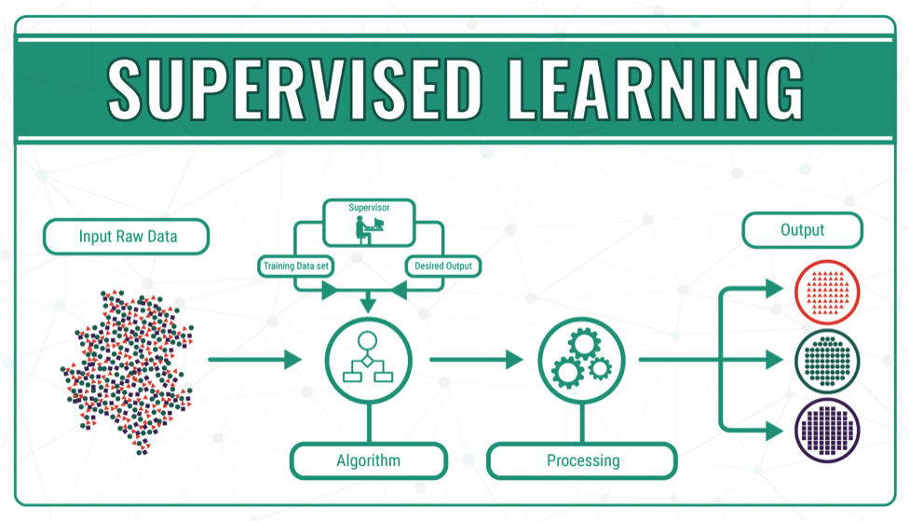
Types of Machine Learning algorithms
Supervised Learning
Supervised learning is basically with the concept of function approximation, where basically we train an algorithm and in the end of the process we pick the function that best describes the input data, the one that for a given X makes the best estimation of y (X -> y).

Slide 26
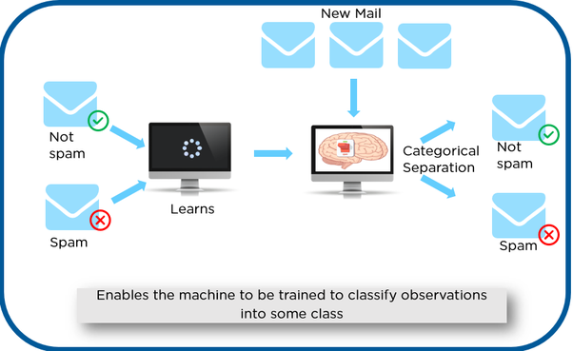
Types of Machine Learning algorithms
Supervised learning
Here the human experts acts as the teacher where we feed the computer with training data containing the input/predictors and we show it the correct answers (output) and from the data the computer should be able to learn the patterns.

Slide 27
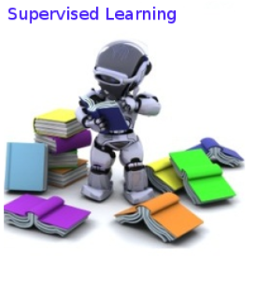
Types of Machine Learning algorithms
Supervised learning algorithms try to model relationships and dependencies between the target prediction output and the input features such that we can predict the output values for new data based on those relationships which it learned from the previous data sets.

Slide 28

Types of Machine Learning algorithms
Note that it consists of Classification and Regression Algorithms. The target variable is known and so it is called supervised learning. For example, when you rate a movie after you view it on Netflix, the suggestion which follows is predicted using a database of your ratings (known as the training data). When the problem is based on continuous variables, (maybe predicting the stock price) then it falls under regression. With class labels (such as in the Netflix problem), the learning problem is called a classification problem.

Slide 29
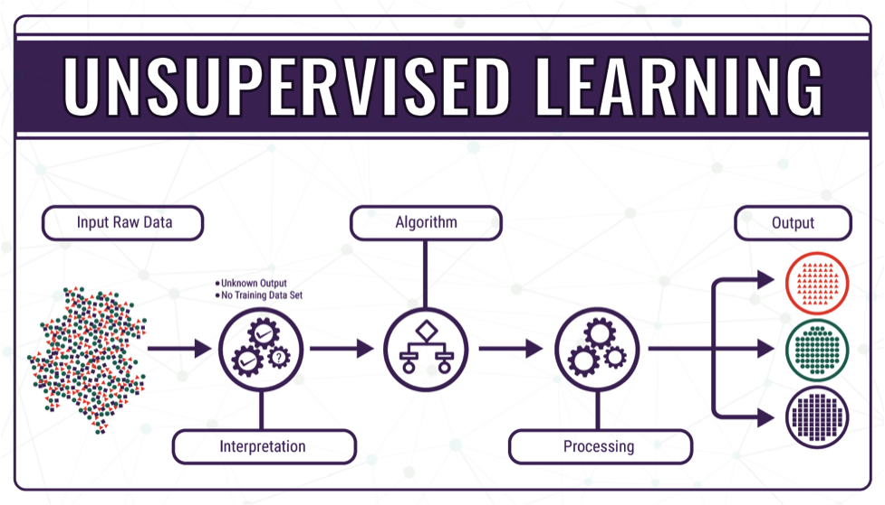
Types of Machine Learning algorithms
Unsupervised Learning
It consists of Clustering Algorithms. The target variable is unknown and so it is called un-supervised learning. In the case of unsupervised learning, there is no labelled data set which can be used for making further predictions.

Slide 30
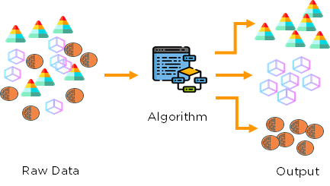
Types of Machine Learning algorithms
The learning algorithm tries to find patterns or associations in the given data set. Identifying clusters in the data (as in the customer segmentation problem) and reducing dimensions of the data falls in the unsupervised learning category.

Slide 31
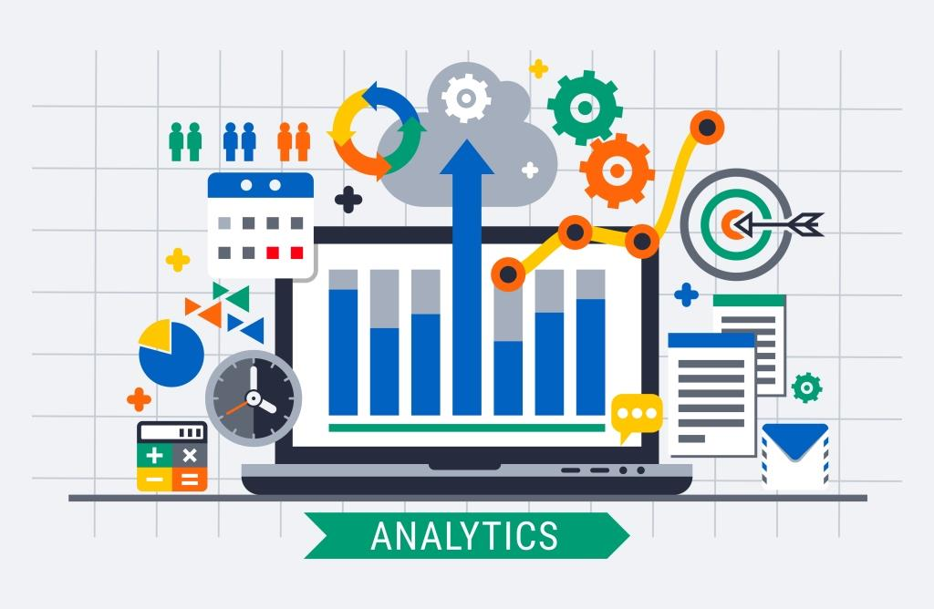
Data Analytics/Analysis
Data analysis is a process of inspecting, cleansing, transforming, and modeling data with the goal of discovering useful information, informing conclusions, and supporting decision-making.
Techniques of Data Analysis:
Data Mining (Predictive Data Analysis)
Business Intelligence (Actionable Business Information)
Data Visualization (Representation of Data)

Slide 32
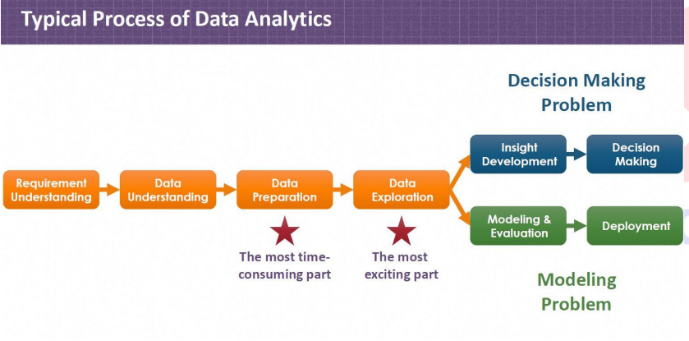
Process of Data Analytics

Slide 33
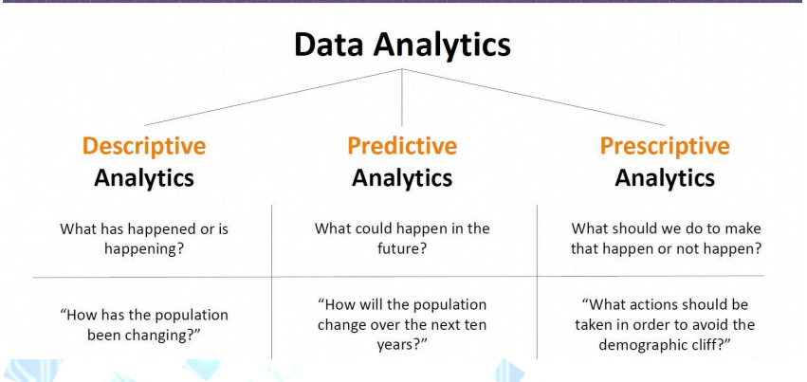
Types of Data Analytics

Slide 34
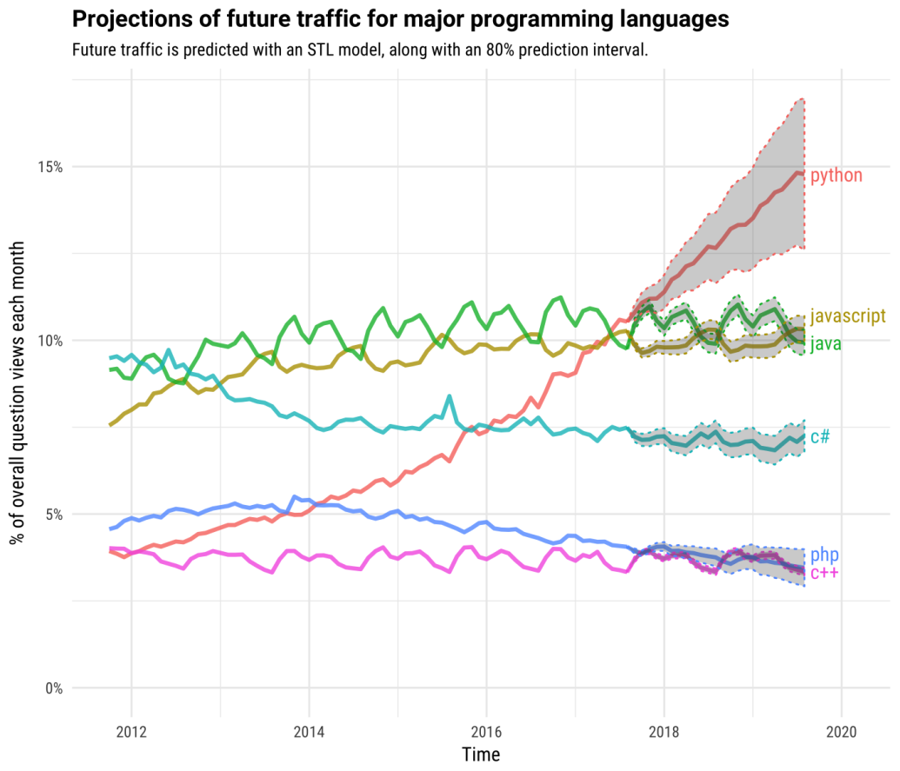
Why Python?
You might have heard about the python which is the topmost programming language of the computers. It is a high-level programming language which is having dynamic semantics. As it, language is very easy and readable, so it reduces the cost of program maintenance.

Slide 35
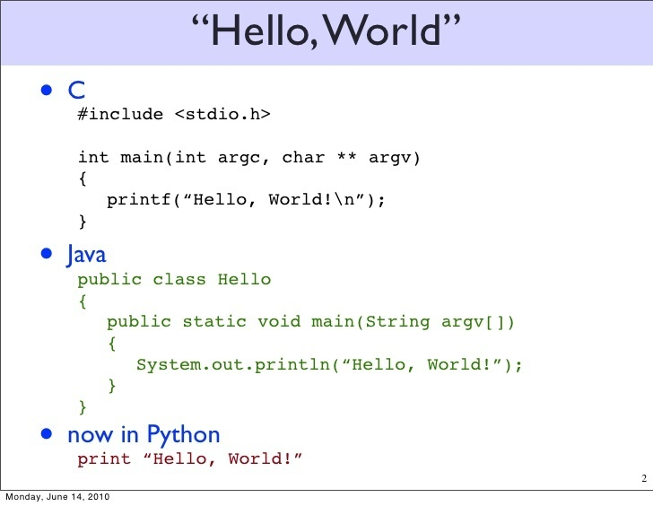
Why Python?
One of the major advantages of its being easy is that it is very easy to interface with other languages as well particularly with C and C++, problems are solved with shorter codes.

Slide 36


Slide 37


